Slide 1
Assembly instruction

Slide 2
FreiBox Active Commutator V2: Overview
2
STL files
1
CommutatorBase
5
4
3
Component list
PulleyLinker
Linker_Part1
Linker_Part2
Detector_Part1
Detector _Part2

Slide 3
Instructions
Before to assemble the commutator, please read below!!
Print and collect all the parts
Before final assembly, you must first build:
The pulley linker part (nuts insertion + pulley gluing)
The ring detector (capacitor and connector to be soldered to the hall sensor + gluing to the Detector _Part1 and Part2)
Solder the 2x U.FL (male) connectors to the slip ring and the miniscope cable end. Secure them with cement or epoxy.
Solder the miniscope cable to the slip ring
Once the previous steps have been completed, you can assemble all the parts.
Then you can superglue the magnet to miniscope cable. The magnet must be placed to the hall detector centers.
Ballast the miniscope (or neuropixel) cable with M5/M6 nuts. This stabilizes the movement of the magnet without altering the weight on the mouse

Slide 4
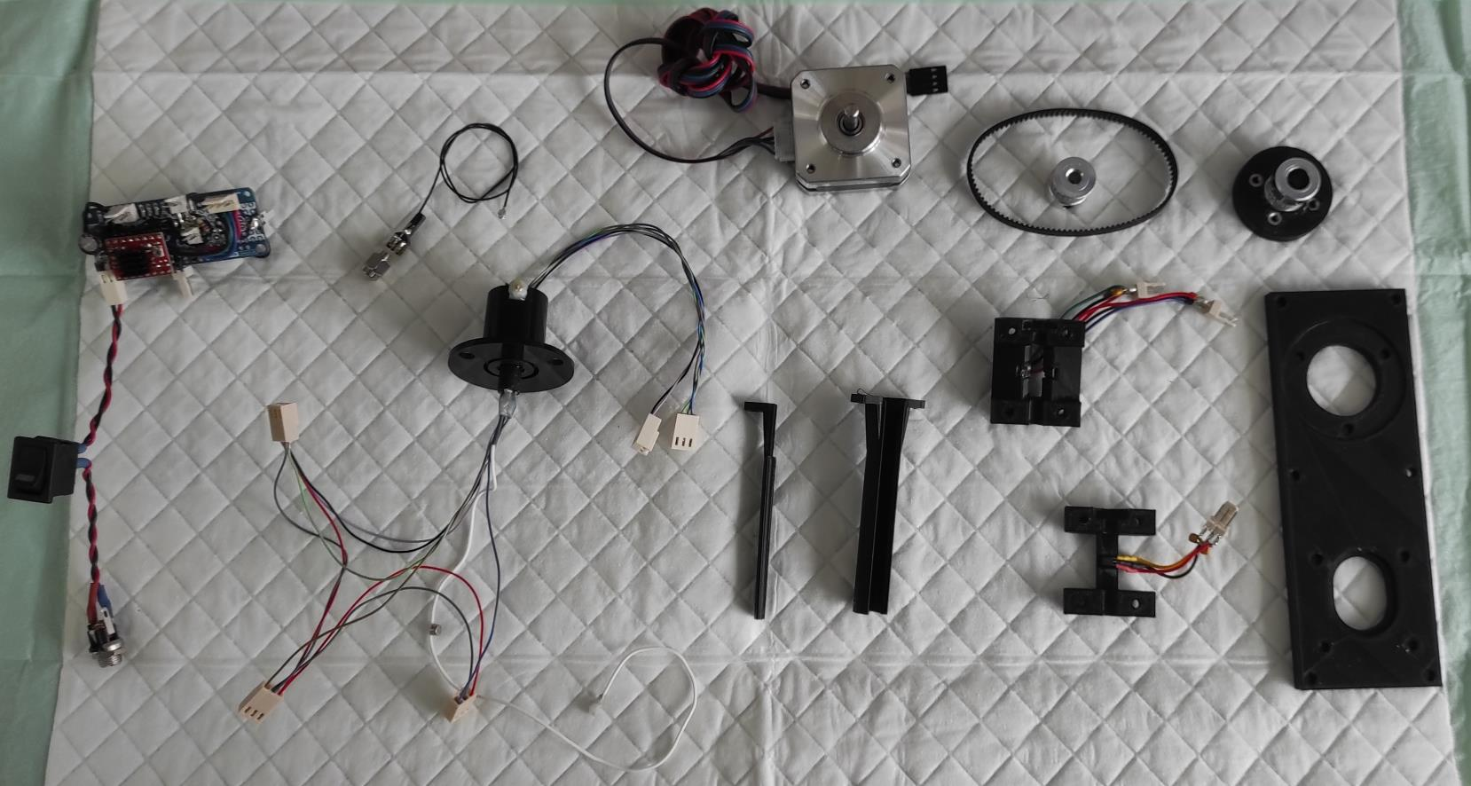
Collect all parts before the assembling
Assembled slip ring
CommutatorBase
Detector _Part2
Linker_Part1
Linker_Part2
Detector_Part1
Electronic
Circuit + Nano every
Nema
step motor
PulleyLinker
U.FL (Female) to SMA cable
(to connect to the DAC)
Timing pulley
And timing belt

Slide 5
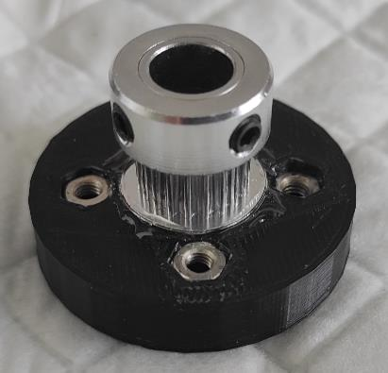
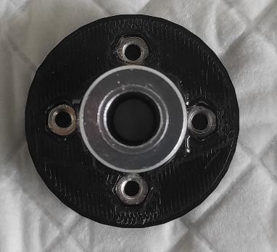
Assembling of the pulley linker
First insert the M3 nut into the 4 corresponding slots of the linker pulley
Then, glue the pulley linker to the with the GT2 timing pulley 8mm bore with epoxy. Avoid getting glue in the bore or in the nuts.

Slide 6
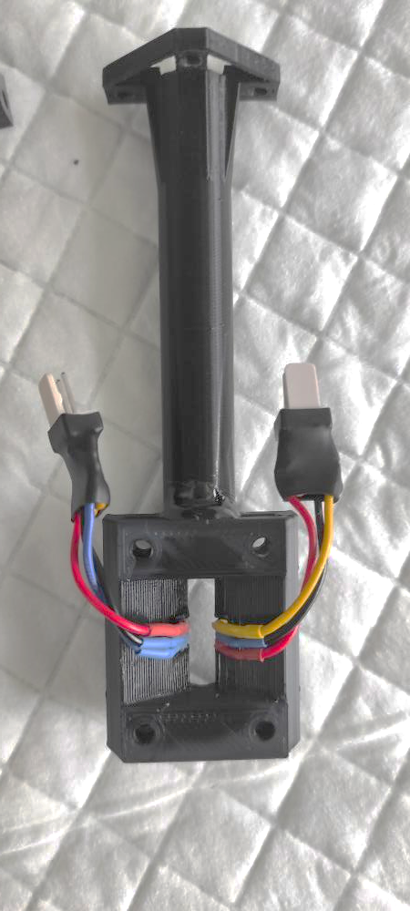
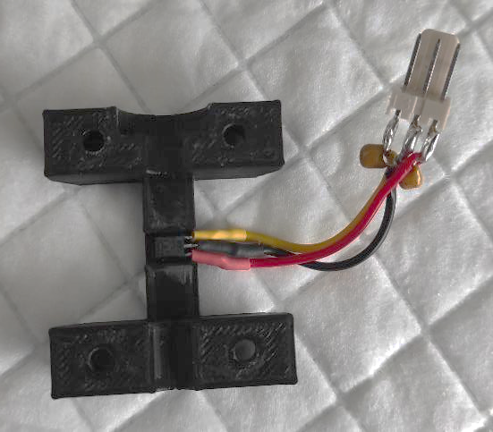
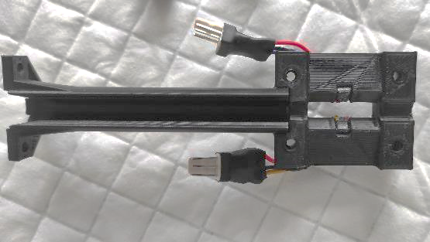
The ring detector
1. Solder the capacitor to the hall sensor as shown
2. Stick the Hall sensor to the Ring Detector Part1 and Part2 with superglue
3. Using epoxy, glue the Detector_Part1 to the Linker_Part1
4. Insert the nuts into their corresponding slots (see arrows)
Epoxy
Signal/GND/5V

Slide 7
Assembled slip ring
Extended Data Figure 4-1
10.1523/ENEURO.0469-22.2023
The signals from the Miniscope (GND and 5V) and the Hall sensors (GND, 5V and the 3 analog signals from the hall sensors) are relayed via a slip ring and send to the Arduino.
We decided to use the U.FL connector to keep the possibility of changing a possible broken cable or connecting another miniscope. However, we strongly advise avoiding repetitive connection/disconnection of the U.FL connectors. As for the miniscopes, they are a little fragile. Instead you should have a commutator for each miniscope/setup since the price is cheap

Slide 8
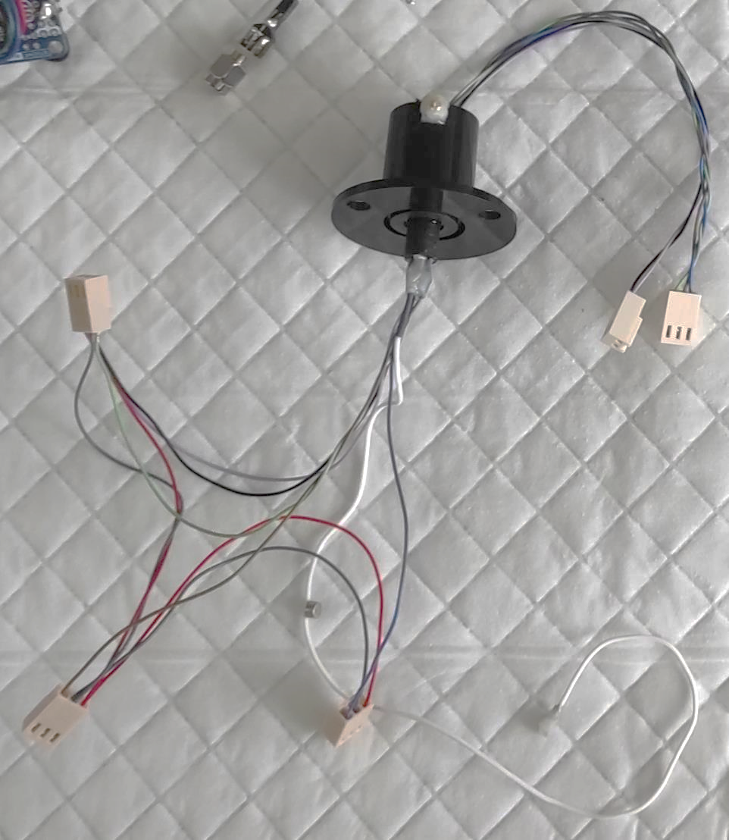
Assembled slip ring
U.FL
(Male)
1. Miniscope cable soldering to Slip ring
/!\ Minimize the length of the cable coming from the slip ring
2. U.FL soldering to Slip ring
3. U.FL soldering to miniscope cable
4. Check the connectivity !! A shortcut between the 2 miniscope cables can damage the DAQ!!!
5. Fixing with epoxy/cement
/!\ Minimize the Epoxy to ensure that the 8mm bore pulley linker is still fitting around the slip ring rotor (* on the photo).
Connectors for the
3 hall sensors
(GND, 5v and signal)
*
<8mm
GND
and 5v
4mm
magnet
3 analogic
signals
U.FL
(Male)
Miniscope cable

Slide 9
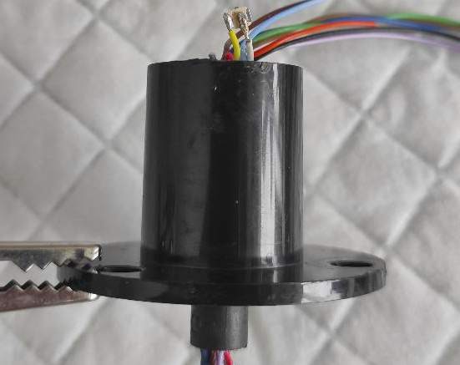
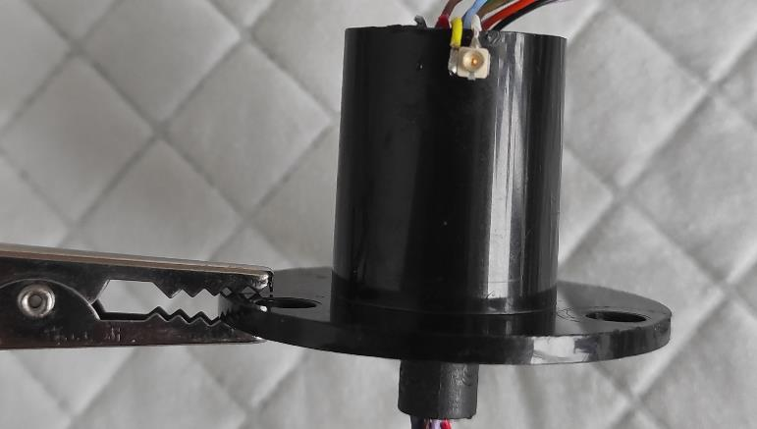
U.FL soldering to the Slip ring
GND
Signal

Slide 10
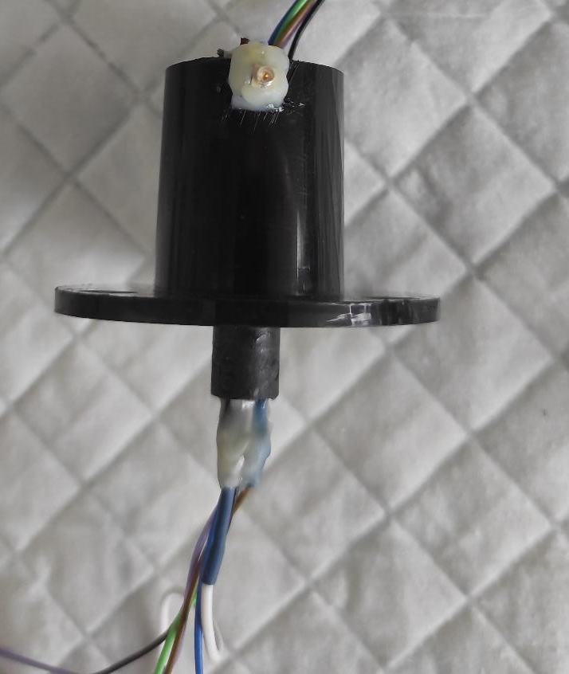
After having testing the U.FL connectivity, secure the U.FL connector to the slip ring with Epoxy/Cement
We also advice to glue the miniscope cable
with epoxy as shown
*
/!\ Minimize the Epoxy to ensure that the 8mm bore pulley linker is still fitting around the slip ring rotor (* on the photo).
<8mm

Slide 11
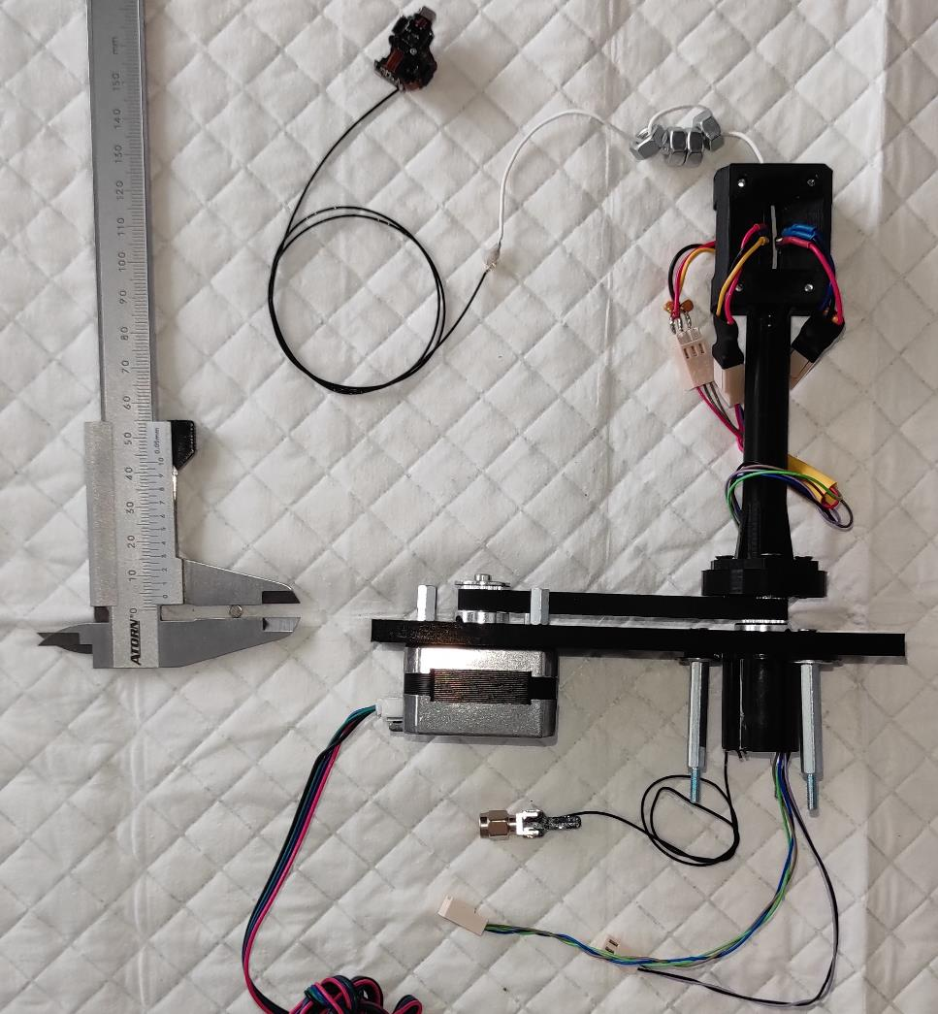
Final assembly
The nuts are used to ‘ballast’ the miniscope cable.
Particularly useful for other flexible cables such as the neuropixel cable

Slide 12
Electronic circuit
Extended Data Figure 4-1
10.1523/ENEURO.0469-22.2023
G–I, To build the FreiBox commutator, the 3 Hall sensors (G) and a motor driver card (H) are connected to the step motor and the Arduino; the signals from the Miniscope and the Hall sensors are relayed via a slip ring (I).

